Slide 1
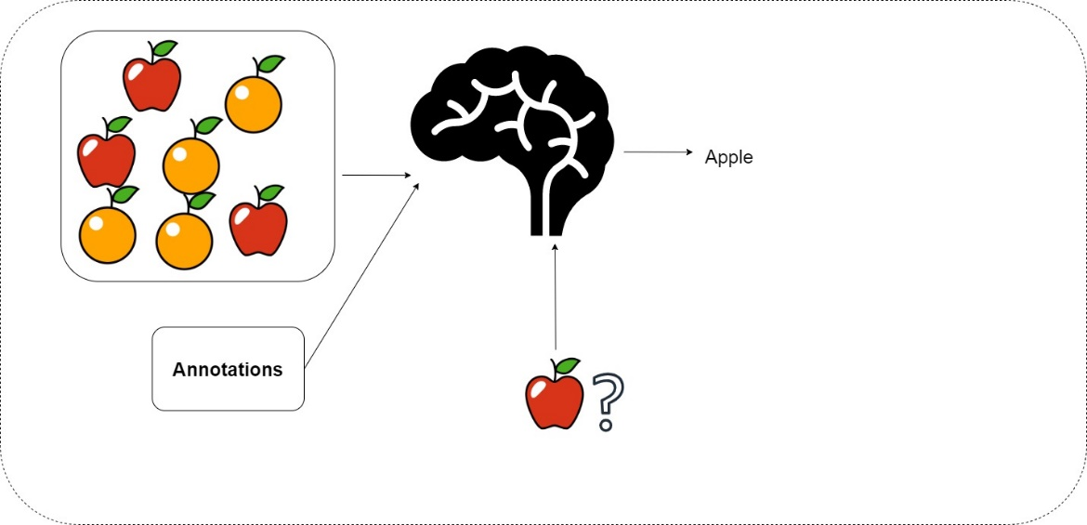
The Machine Learning Landscape
1
- Dr. Sifat Momen (SfM1)

Slide 2
Learning goals
After this presentation, you should be able to
Explain what machine learning is
Understand the different machine learning systems
Know different jargons related to machine learning
Understand the main challenges in machine learning
Understand the ethical concerns in machine learning

Slide 3
CSE 445: Machine Learning
Welcome to CSE 445: Machine Learning – Summer 2024
I am offering two sections this semester
Please note that you are not allowed to take classes (and specifically exams) in other sections
This is a senior level course
It is expected that students should be able to demonstrate high degree of maturity
This includes reading and learning on own from existing literature, writing codes, conducting experiments, analyzing results and writing good technical paper(s).

Slide 4
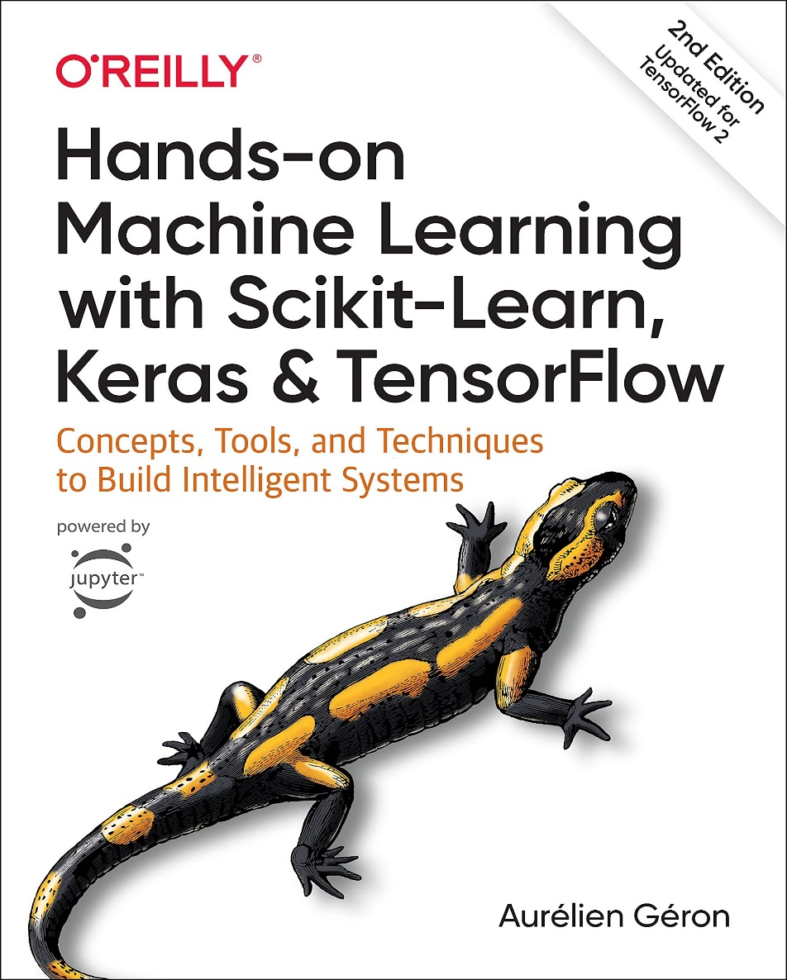
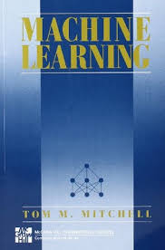
Recommended Materials
Lecture Materials
Scholarly Papers

Slide 5
Project
The objective of the project work is for you to
Experience a hands on skills in ML.
Students will have to do innovative projects.
I am not expecting the projects to have commercial value but it must address a realistic problem and should solve it.
It should be ideally publishable in a reputed conference/ journal.

Slide 6
What is expected of you?
Work hard
Have an inquisitive mind
Continued effort (You will not be able to do anything magically overnight)
Consistency is the key to do well in this course
You need to have some backgrounds in
Linear Algebra Calculus Statistics Algorithms

Slide 7
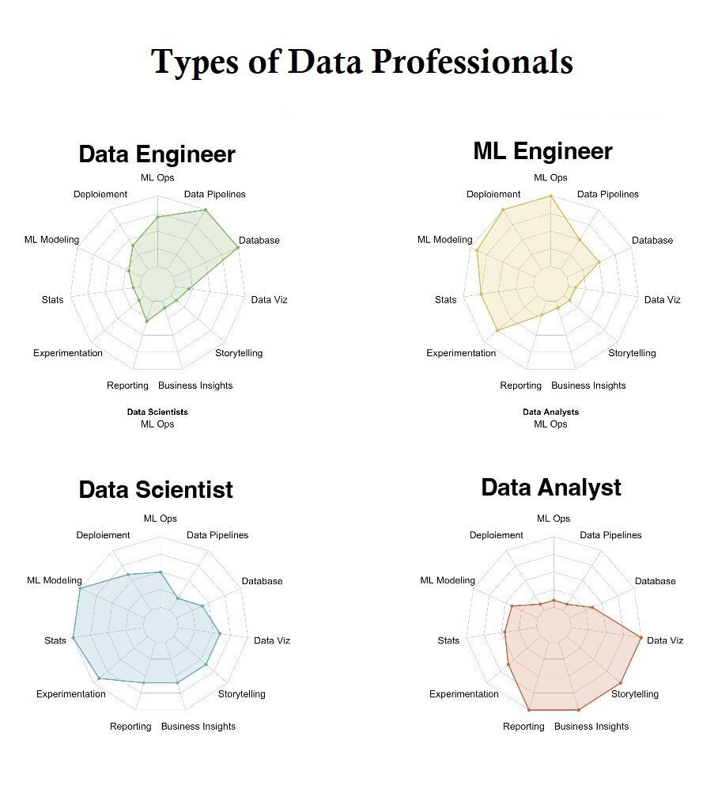

Slide 8
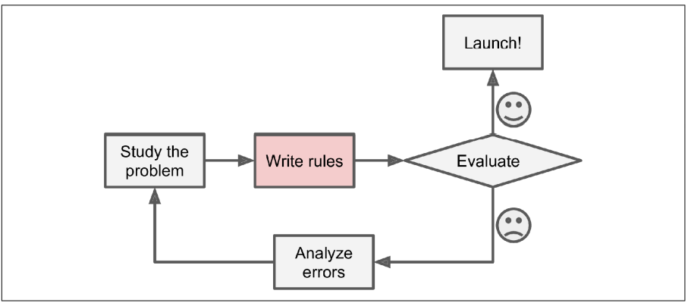
Traditional Approach to Solving Problems

Slide 9
What is Machine Learning?
The best way to understand what a machine learning is and appreciate the notion of it is to start with an example.

Slide 10
A Thought Experiment
Imagine we have a physical machine that can take the side-view picture of an object placed on it and measure the weight of the object.
Object placed is either an orange or an apple
The measurable features in this thought experiment are color and weight

Slide 11

A Thought Experiment
Now, you are tasked to write a program that determines if the object placed is an apple or an orange. How would you do that?

Slide 12

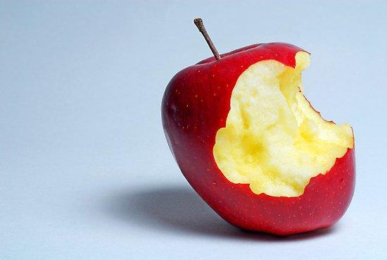
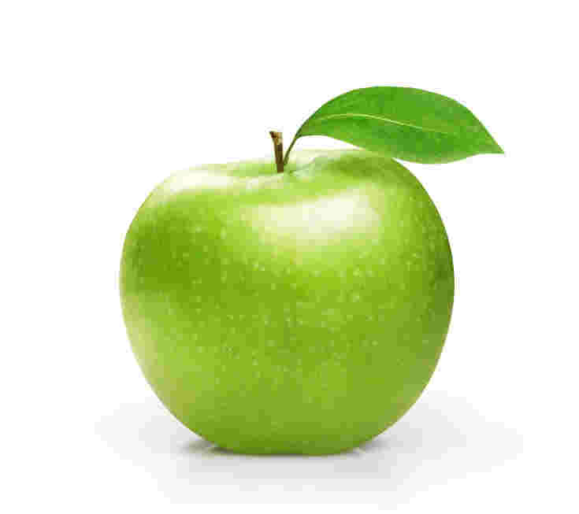
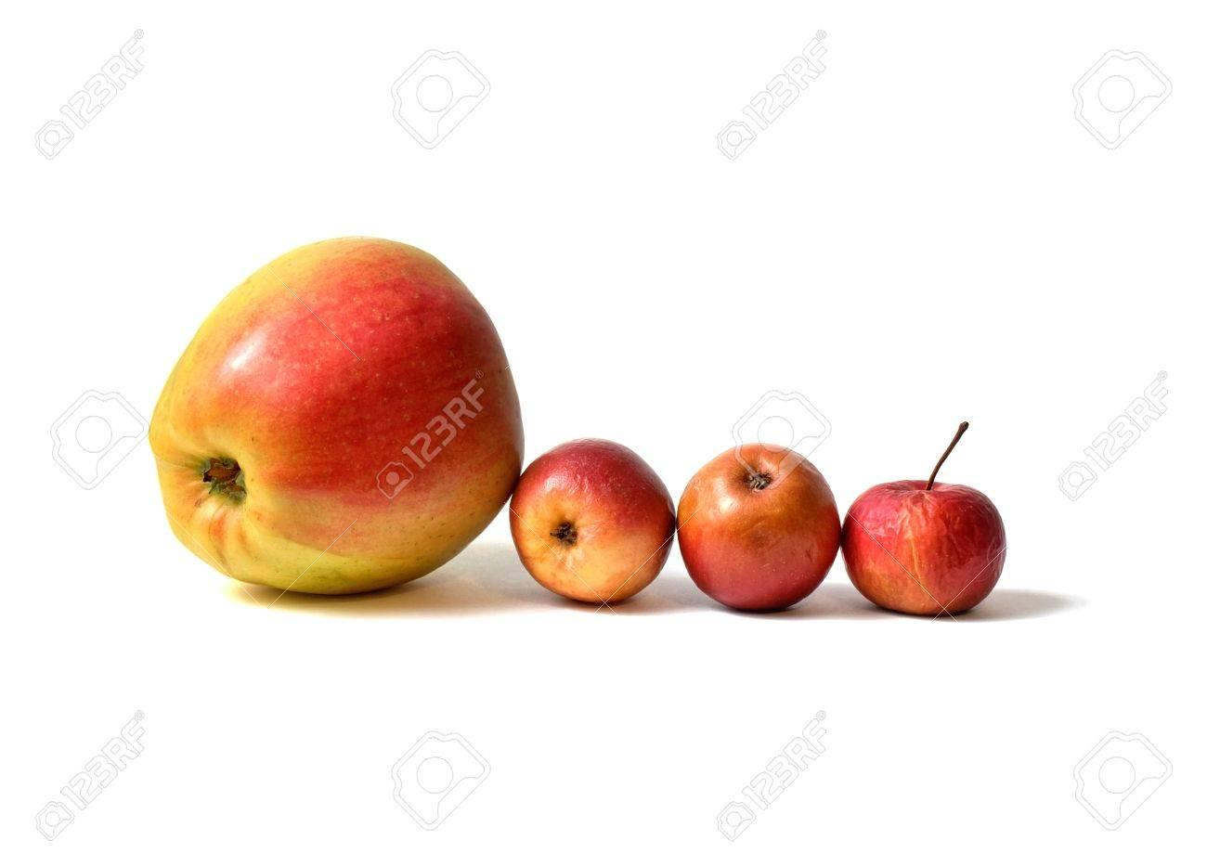
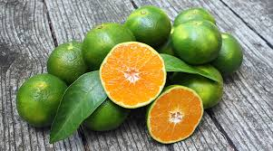
Real World

Slide 13
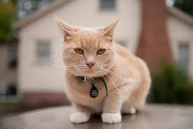

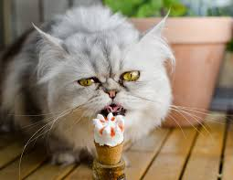
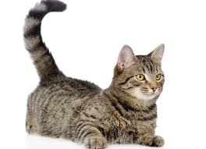
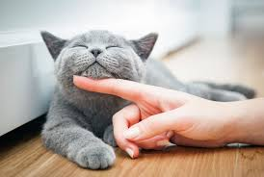





What about recognizing a cat from a picture?

Slide 14
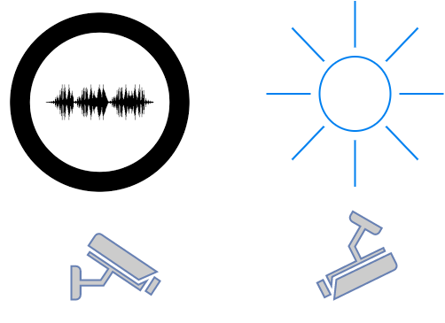
Real World Data
Noisy
Illumination
Occlusion
Camera angle
Exists a wide range of variation (in terms of features such as color, texture, weight etc..)

Slide 15
Real World Data (cont…)
Consequently, it is impossible to write a rule based programming to recognize a cat or differentiate between fruits (such as orange and apple)
A shift in the paradigm is required
Data driven Computing (Welcome to Machine Learning)
We use data to create model
Data is at the core of ML
Without data, you will not be able to run a ML project.

Slide 16
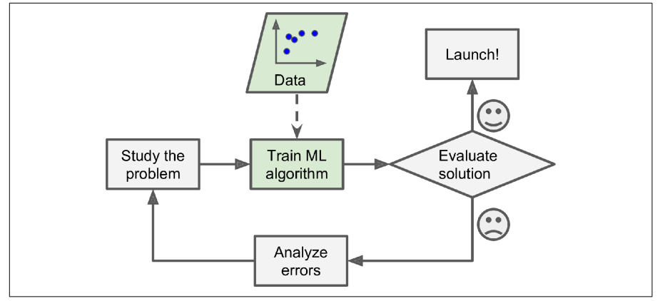
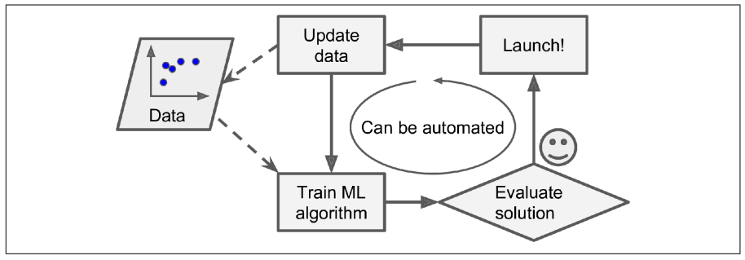
Machine Learning Approach

Slide 17
Well posed learning problems
Machine Learning
It is a science that grew up from AI
The term, ML, was coined in 1959, by Arthur Samuel
Machine Learning is the field of study that gives computers the ability to learn without being explicitly programmed (Arthur Samuel, 1959)
A computer program is said to learn from experience E, with respect to some task T and performance measure P if its performance at task T, as measured by P, improves with experience E. (Tom M. Mitchell)

Slide 18
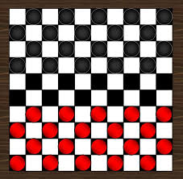
Checkers learning problem
Task T: playing checkers
Performance measure, P: % of games won against opponents
Training Experience, E: Playing practice games against itself

Slide 19
Handwriting Recognition Problem
Task T: Recognizing and classifying handwritten words/characters within images
Performance measure P: % of words/characters correctly classified
Training Experience, E: Predicting the word/character from a collection of handwritten words/characters with given classifications
MNIST Dataset (Yann Lecunn et al.)
BanglaLekha Isolated (Nabeel Mohammed, Sifat Momen et al.)
https://data.mendeley.com/datasets/hf6sf8zrkc/2
Dataset comprises of 50 Bangla basic characters, 10 bangla numerals and 24 selected compound characters (total of 1,66,105 handwritten character images)

Slide 20
Robot driving learning problem
Task T: driving on public highways using vision sensors
Performance measure, P: Average distance travelled before an error (as judged by a human observer)
Training Experience, E: A sequence of images and steering commands recorded while observing a hums driver.

Slide 21
Classifying an incoming email as either a spam or not spam
Task T: Correctly classify an email as either spam or not spam
Performance measure, P: % of emails correctly classified
Training Experience, E: A repertoire of emails with proper labeling as either spam or not.

Slide 22
Some Applications of Machine Learning

Slide 23
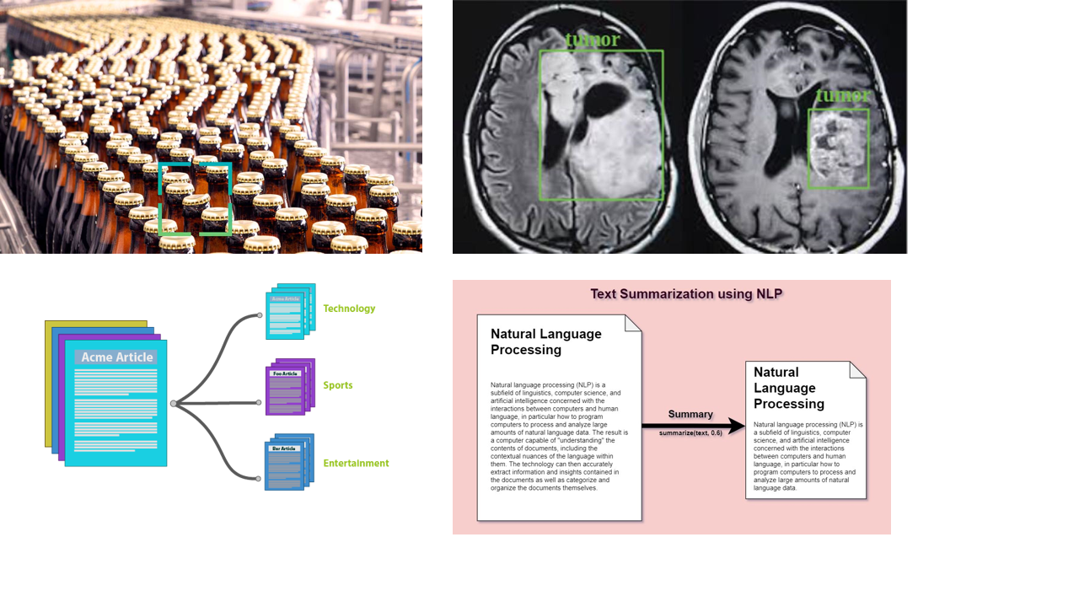

Slide 24



Write a story with dolphins and turtles as characters and include a moral in the story

Slide 25
Once upon a time, in a beautiful coral reef deep in the ocean, there lived a group of dolphins and a group of turtles. The dolphins were known for their intelligence and speed, while the turtles were known for their wisdom and long lives. The two groups lived separately and rarely interacted with each other. The dolphins were always busy swimming and playing, while the turtles were content to take their time and enjoy the peacefulness of the reef. One day, a group of humans came to the reef to fish. They used big nets to catch fish, not caring if they caught anything else in the process. In the process, they caught many of the reef's inhabitants, including the dolphins and turtles. The dolphins, being faster and more agile, managed to escape the nets, but the turtles were not as lucky. Many of them were caught and taken away. The dolphins felt guilty for not being able to help their friends and decided to come up with a plan to save the turtles.

Slide 26
They used their intelligence and speed to come up with a strategy to chase the fishing boat away and free the trapped turtles. The plan was successful and the boat was chased away, but not before many of the turtles were harmed. The dolphins and turtles were able to free the remaining turtles and bring them back to the reef. After that experience, the dolphins and turtles realized the importance of working together. They learned that each of them had unique strengths and weaknesses, and that by combining their abilities, they could protect the reef and all its inhabitants better. From then on, the dolphins and turtles worked together, and the reef was safe and prosperous once more. The moral of the story is that everyone is unique, and we all have different strengths and weaknesses, but when we work together, we can achieve so much more. Unity is strength and cooperation leads to protection of environment and preserving lives.

Slide 27
Write a rap about North South University

Slide 28
Verse 1:
Listen up y'all, I got a story to tell
About a uni that's doing well
North South University, the name you should know
Where education and knowledge both flow
Chorus:
North South, North South
We're the best, no doubt
North South, North South
We're reaching new heights, without a doubt
Verse 2:
From BBA to Engineering, we got it all
We're making sure you're ready for the call
Professors who care, and a campus so fine
We're creating leaders, one student at a time

Slide 29
Chorus:
North South, North South
We're the best, no doubt
North South, North South
We're reaching new heights, without a doubt
Verse 3:
Research and innovation, that's our game
We're putting Bangladesh on the map, with our name
We're not just a uni, we're a community
We're here to empower, and set you free
Chorus:
North South, North South
We're the best, no doubt
North South, North South
We're reaching new heights, without a doubt

Slide 30
Outro:
So come and check us out, and take a tour
North South University, where your future is secure.

Slide 31
Types of Machine Learning Systems
Various Types of Machine Learning Systems based on the following criteria:
Whether or not they are trained with human supervision (supervised, unsupervised, semi-supervised, reinforcement learning)
Whether or not they can learn incrementally on the fly (online versus batch learning)
Whether they work by simply comparing new data points, or instead by detecting patterns in the training data and building a predictive model(instance-based versus model-based learning)

Slide 32
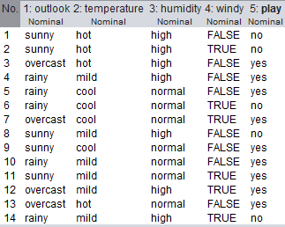
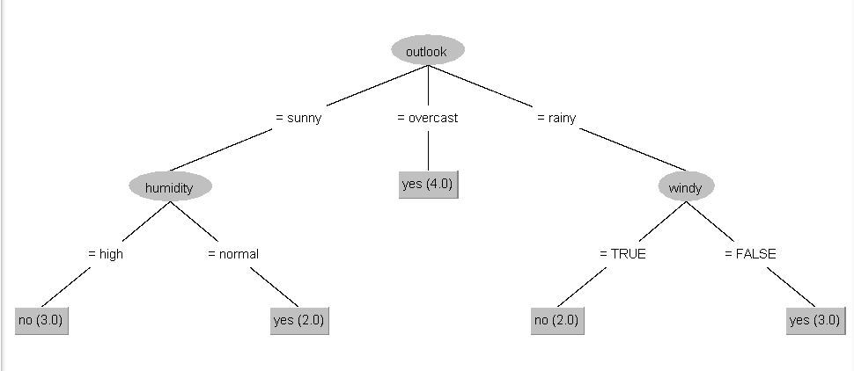
Supervised Learning
In supervised learning, the algorithm builds a mathematical model from a set of data that contains inputs and labels (desired outputs) <X, y>.
The data contains 14 instances and 4 attributes. The target variable is play
A Decision Tree Model

Slide 33
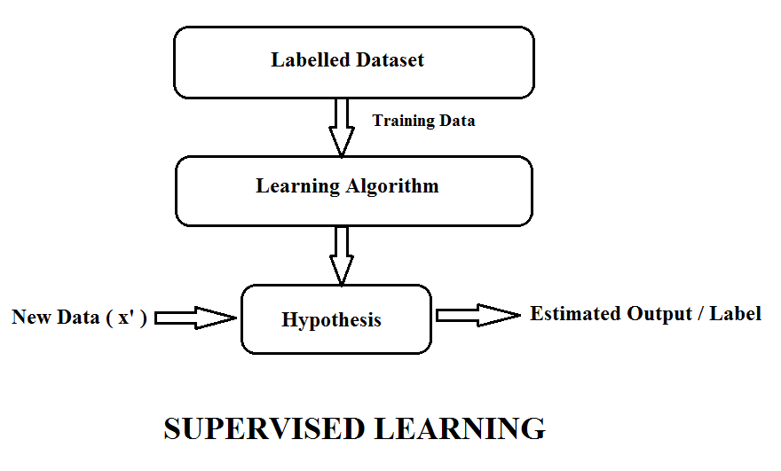
Supervised Learning

Slide 34
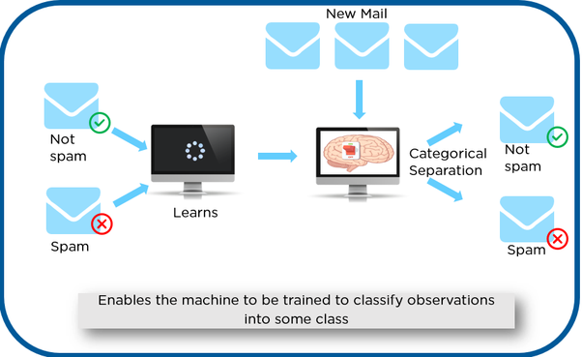
Supervised Learning - Classification

Slide 35
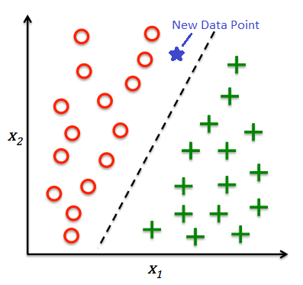
Supervised learning - Classification

Slide 36
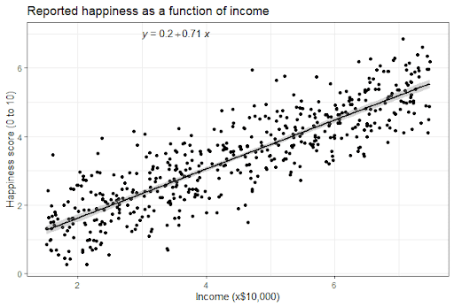
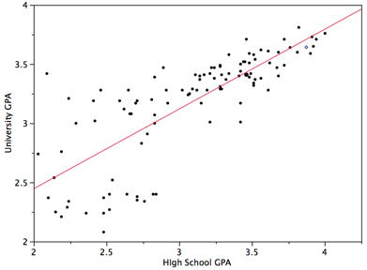
Regression

Slide 37
Examples of Supervised Learning Algorithms
K-Nearest Neighbors
Linear Regression
Logistic Regression
Support Vector Machines
Decision Trees
Random Forests
Neural Networks
…

Slide 38
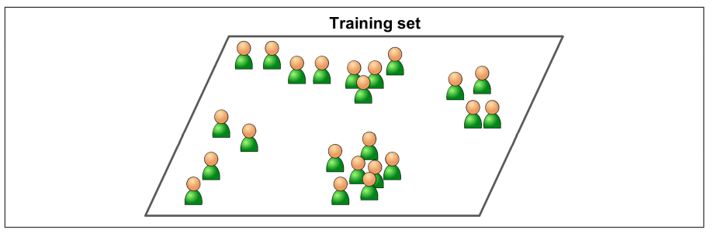
Unsupervised Learning
In Unsupervised Learning, the training data is unlabeled. The system tries to learn without a teacher.

Slide 39
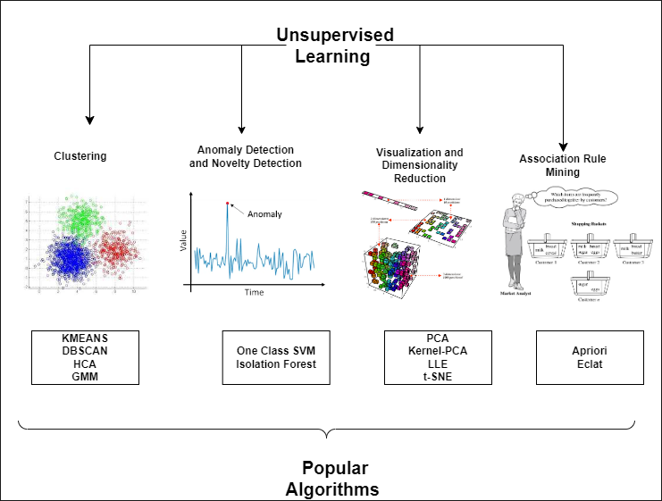
Unsupervised Learning

Slide 40
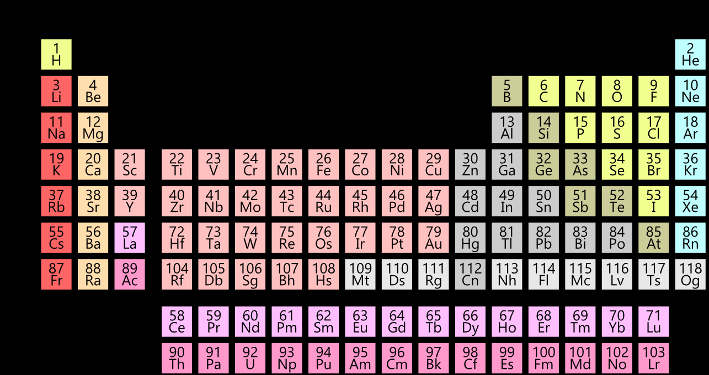
Unsupervised Learning

Slide 41
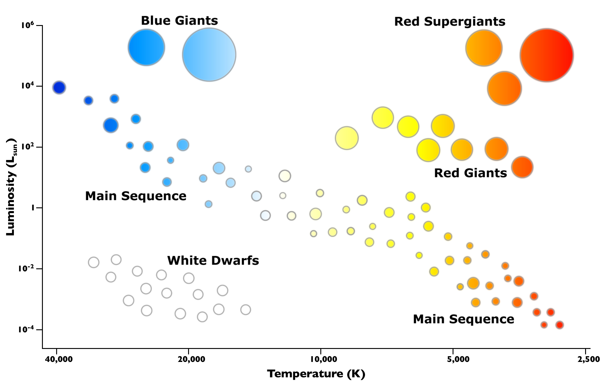
Unsupervised Learning

Slide 42
Semi-Supervised Learning
Supervised learning works on labeled data
Unsupervised learning works on unlabeled data
In Semi-Supervised learning, the training data contains both labeled and unlabeled data
Scenario
We have a large dataset. Manual labeling of the entire dataset is laborious and expensive
One solution could be to label a sample of the dataset and train the labeled portion to create a model. This would however mean that we are not fully utilizing the larger dataset we have and thus the model that we create may be less robust
A potential solution: (1) Label a sample of the large dataset, (2) train a model using this labeled portion, (3) use the model to predict the unlabeled portion (pseudo-labeling), (4) train using the entire dataset

Slide 43
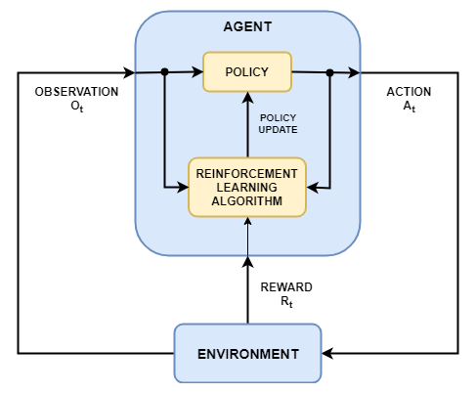
Reinforcement Learning

Slide 44
Batch and Online Learning
Another criterion used to classify Machine Learning Systems is whether or not the system can learn incrementally from a stream of incoming data
Batch Learning
Incapable of learning incrementally
It must be trained using all available data
Generally takes a lot of time and computing resources – so it is typically done offline
Hence, also known as offline learning

Slide 45
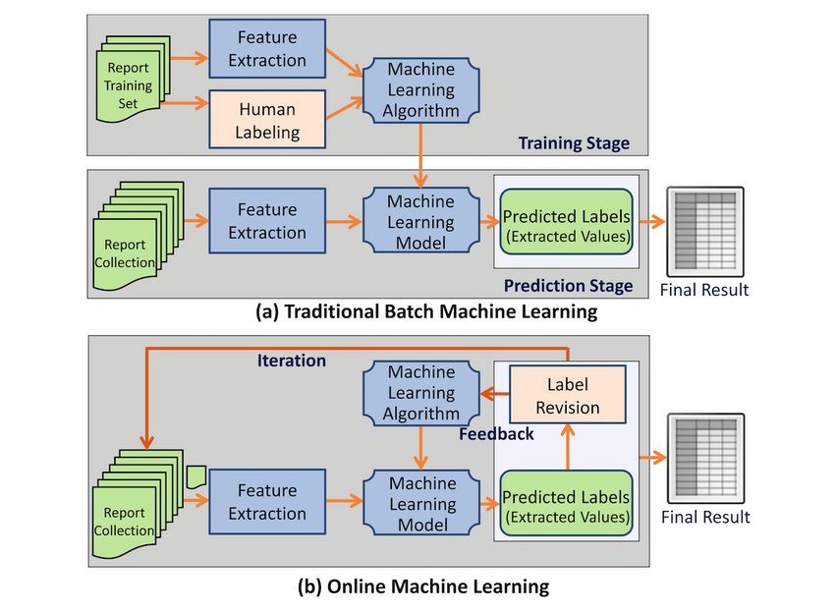
Batch Versus Online Learning
Online Learning is great for systems that receive data as continuous flow (e.g. stock prices) and need to adapt autonomously.
It is also a good option if you have limited computing resources – Once an online learning system has learned about new instances, it does not need them anymore, so you can discard them
Online learning algorithms can also be used to train systems on huge datasets that cannot fit in one machine’s main memory (this is called out of core learning ). The algorithm loads part of the data, runs a training step on that data, and repeats the process until it has run all of the data

Slide 46
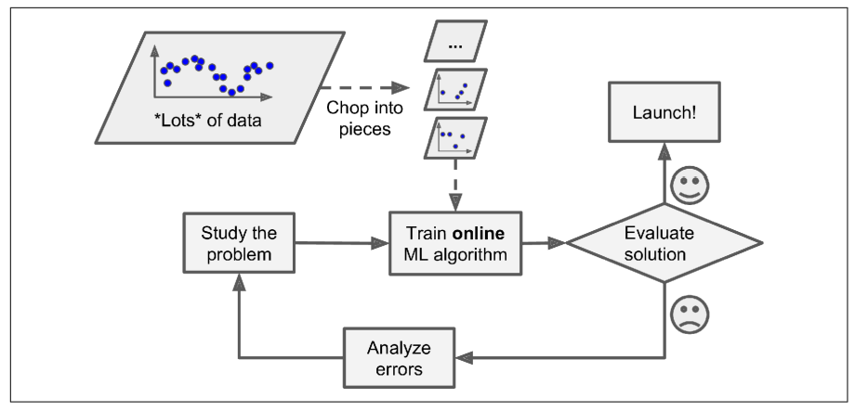
Online Learning to Handle Large Dataset

Slide 47
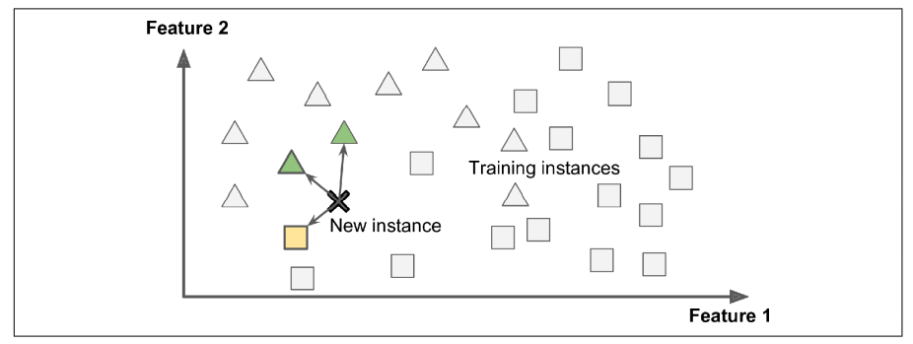
Instance Based Versus Model Based Learning
One more way to classify machine learning algorithms is by how they generalize.
Instance Based Learning
The most trivial form of learning is rote learning (to learn by heart)
System learns the examples by heart, then generalizes to new case by using a similarity measure to compare them to the learned examples (or a subset of them)

Slide 48
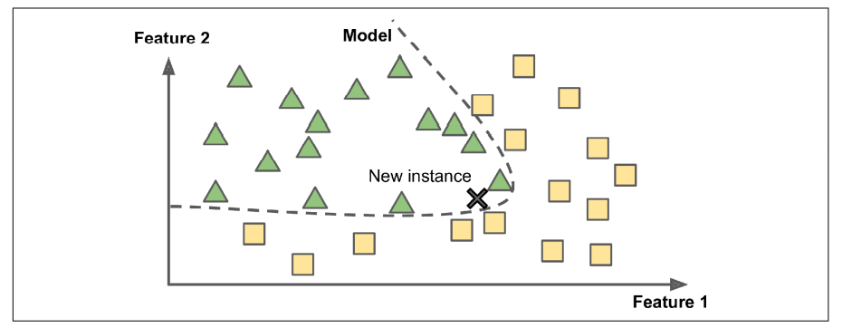
Instance Based Versus Model Based Learning
Model Based Learning
Another way to generalize from a set of examples is to build a model of these examples and then use the model to make predictions

Slide 49
Main Challenges of Machine Learning
Insufficient quantity of training data
Non-representative training data
Poor-quality data
Irrelevant features
Overfitting the training data
Underfitting the training data

Slide 50
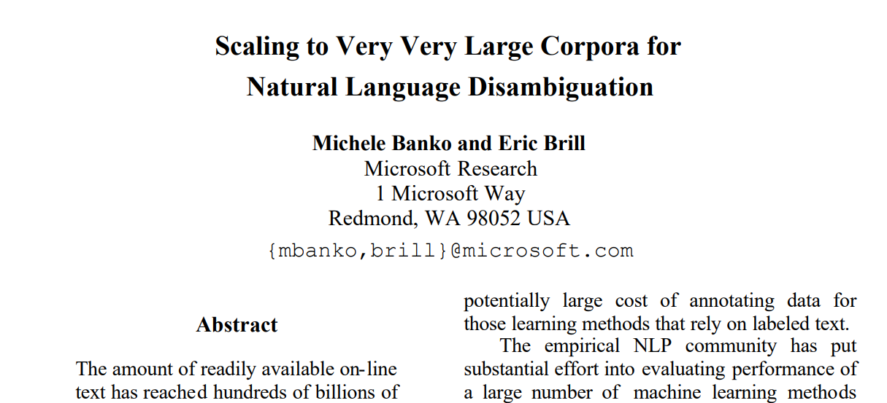
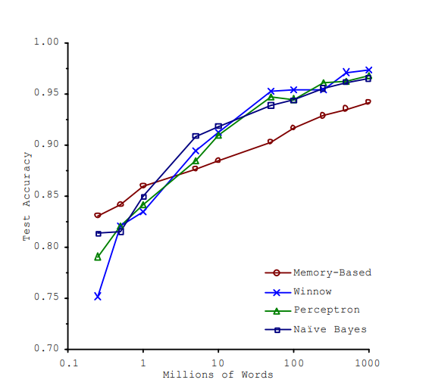
Challenges - Insufficient quantity of training data
ACL_FINAL_REAL3.PDF (acm.org)

Slide 51
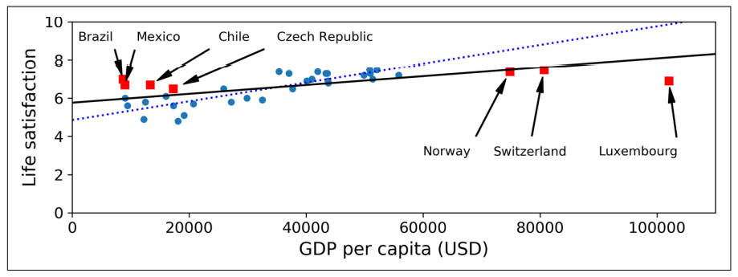
Challenges – Non-representative training data

Slide 52
Challenges – Poor Quality Data
If your training data contains full of errors, outliers, and noise (due to poor quality measurements), it will be harder for the system to detect the underlying patterns, so your system is less likely to perform well

Slide 53
Challenges – Irrelevant Features
Feature Engineering Steps
Feature Selection (selecting the most useful features to train on among existing features)
Feature Extraction (combining existing features to produce more useful ones)
Creating new features by gathering new data

Slide 54
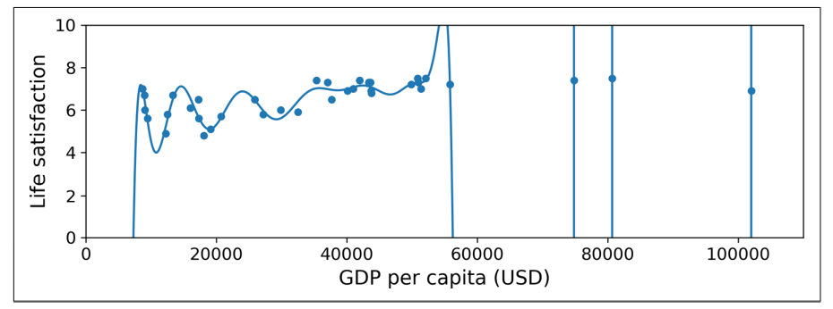
Challenges – Overfitting the training data

Slide 55
Challenges – Overfitting the training data
Overfitting occurs when the model is too complex relative to the amount and noisiness of the training data.
Potential Solutions
Simplify the model by selecting one with fewer parameters, by reducing the number of attributes or by constraining the model
Gather more training data
Reduce the noise in the training data (e.g. fix data errors and remove outliers)

Slide 56
Challenges – Undefitting the training data
It occurs when your model is too simple to learn the underlying structure of the data.
Potential Solutions:
Select a more powerful model, with more parameters
Feed better features to the learning algorithm
Reduce the constraints on the model

Slide 57
Issues related to AI (and more particularly ML)
ML model depends on the data that is fed.
Bias in the data (conscious / unconscious) can be easily picked up by ML models
ML systems used for criminal risk assessment have been found to be biased against black people.

Slide 58
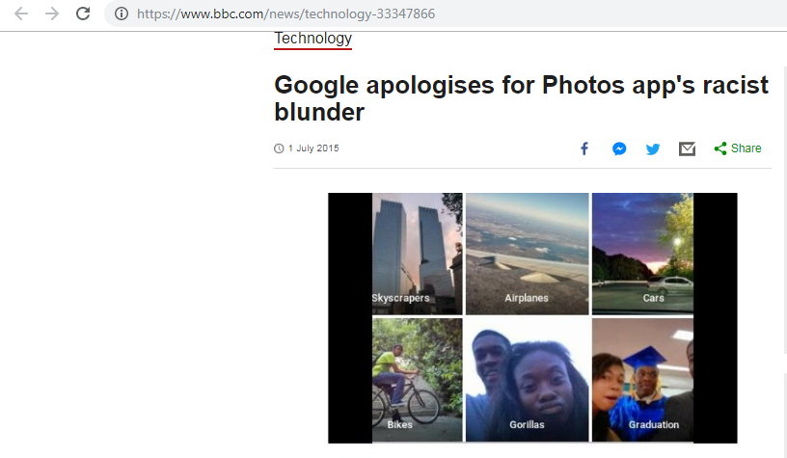
Issues Related to ML

Slide 59
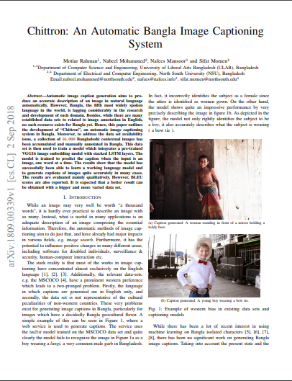

Slide 60
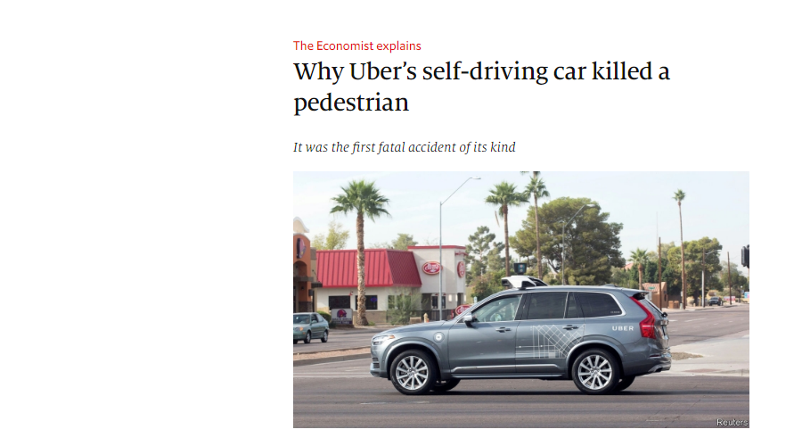

Slide 61
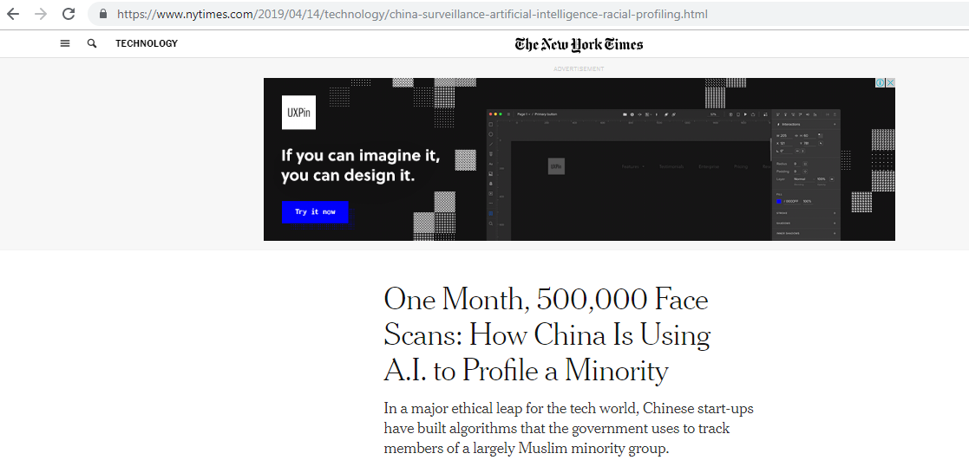

Slide 62
ML and Ethics (More Complex case)
When applied to people, data mining is frequently used to discriminate - who gets the loan, who gets the special offer, and so on.
Certain kinds of discrimination - racist, sexual, religious and so on are not only unethical but also illegal.
Using sexual and racist information for medical diagnosis is certainly ethical but using the same information when mining loan payment behavior is not.

